Slide 1


Collaborative Internal Job Portal
Developed By:
Akash Deep Mishra(1410991042)
Akhilesh Sharda(1410991047)
Akshit Matta(1410991056)
Amandeep(1410991062)
Name | Roll No.
Akash Deep Mishra | 1410991042
Akhilesh Sharda | 1410991047
Akshit Matta | 1410991056
Amandeep | 1410991062

Slide 2
Collaborative Internal Job Portal
Project Statement
Q) Jeff loves playing games, Gluttonous snake (an
old game in NOKIA era ) is one of his favorites’. However, after playing gluttonous snake so many times, he finally got bored with the original rules. In order to bring new challenge to this old game, Jeff introduced new rules:
1. The ground is a grid, with n rows and m columns(1 <= n, m <= 500).
2. Each cell contains a value v (-1 vi 99999), if v is -1, then this cell is blocked, ≤ ≤ and the snake cannot go through, otherwise, after the snake visited this cell, you can get v point.

Slide 3
Collaborative Internal Job Portal
3. The snake can start from any cell along the left border of this ground and travel until it finally stops at one cell in the right border.
4. During this trip, the snake can only go up/down/right, and can visit each cell only once.
Special cases :
a. Even in the left border , the snake can go up and down.

Slide 4
Collaborative Internal Job Portal
b. When the snake is at the top cell of one column, it can still go up, which demands the player to pay all current points , then the snake will be teleported to the bottom cell of this column and vice versa.
After creating such a new game, Jeff is confused how to get the highest score. Please help him to write a program to solve this problem.

Slide 5
Collaborative Internal Job Portal
Input:
The first line contains two integers n (rows) and m (columns), (1 <= n, m <= 500), separated by a single space. Next n lines describe the grid. Each line contains m integers vi (-1 ≤ vi ≤ 99999) vi = -1 means the cell is blocked.

Slide 6
Collaborative Internal Job Portal
Technology Used
Front End/Programming Tool
Codeblocks 13.12
Back End
C++ Language

Slide 7
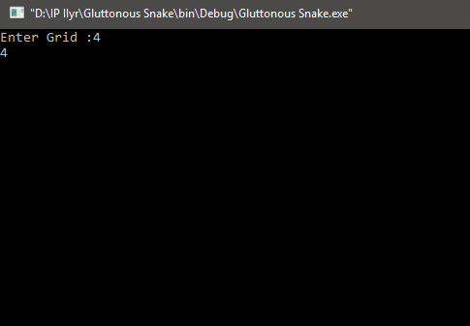
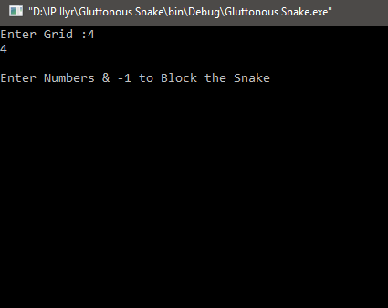
Collaborative Internal Job Portal
Snapshots

Slide 8
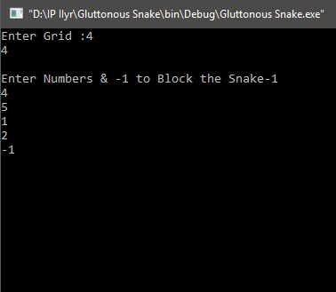
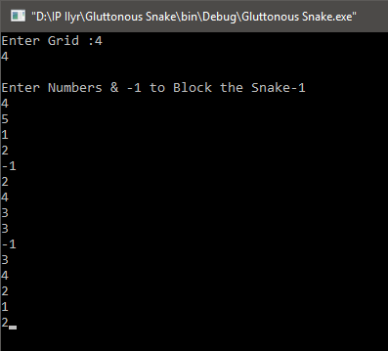
Collaborative Internal Job Portal

Slide 9
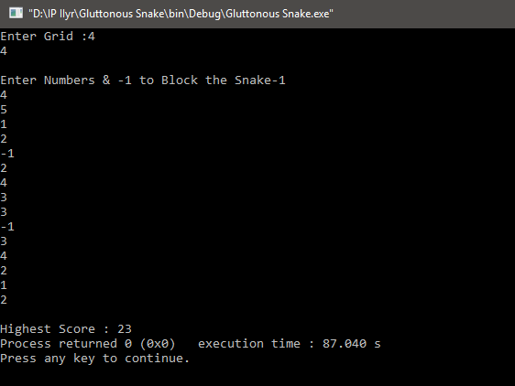
Collaborative Internal Job Portal

Slide 10
cout<<“THANK YOU”;

